Slide 1

DriverPass System Analysis
Andreas Galatis
Notes:
[No speaker notes required for this slide.]

Slide 2

System Requirements
Functional Requirements
Course delivery
Notifications
Non-Functional Requirements
Performance
Adaptability
Notes:
Functional Requirements
Course Delivery: The DriverPass system has to enable students the ability to take practice tests directly on the website and provide immediate results. Instructors also need the ability to access those tests for evaluation.
Notifications: The system also needs to provide students and instructors on-time notifications of upcoming driving appointments and DMV updates on testing availability
Non-Functional Requirements
Performance: The Driver Pass system must support all mobile device formats as well as current web browsers in order to maximum reach for all users. Additionally, the system must provide performance reports and perform regular updates without having service interruptions to ensure outstanding customer satisfaction
Adaptability: The system must allow administrators and users the ability to reset passwords in order to maintain continuous usage in case of forgotten passwords. The system must also be able to have a growing capacity to store large amount of data as the number of user increases over time.

Slide 3
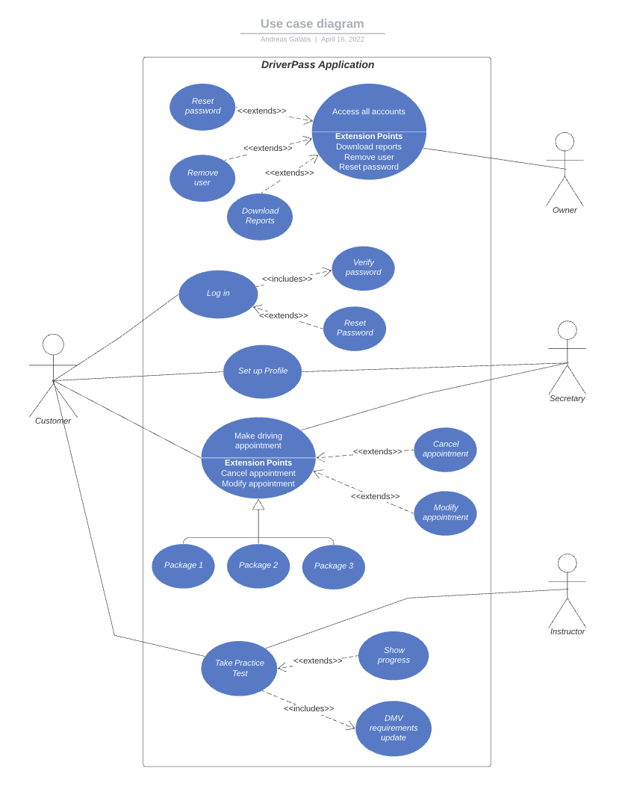
Use Case Diagram
Notes:
The system was designed with four main users in mind: The student, the owner, the secretary, and the driving instructor. The student is the main user who will access the system by logging-in with a password and will have the option to reset that password if forgotten. The student will also be able to set up a profile for their account. Once they access their account, they can then schedule driving appointments as well as take practice tests. The secretary will access the system in response the student to assist with the creation of profiles and making driving appointments. The driving instructor will have access to the system to view and evaluate the student’s practice tests. Lastly, the owner of DrivePass will have complete administrative access to the system to reset passwords, remove accounts, and download activity reports.

Slide 4
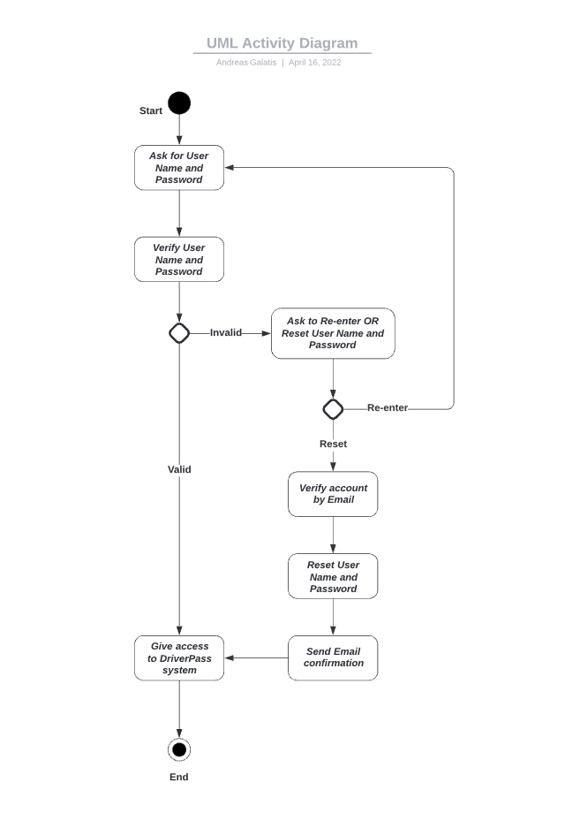
Activity Diagram
Notes:
This diagram details the activity of a student logging-in to the system. The process starts by the system asking the student for a username and password which should have already been set-up in the profile creation. Once entered, the system will verify the username and password, and if it is valid, the system will grant the student access to the program. If the username and password is incorrect, the system will prompt the student to either re-enter the information or reset their username and password. If the student chooses to re-enter the information, the system will loop back to the beginning of the process. If they choose to reset their username and password, the system will verify their account by their email and give them the option to create a new username and password. Once created, the student will be sent an email confirmation and granted access to the program. The process ends once the student has access to the program.

Slide 5
Security
The system shall have a public cloud-based environment with authentication
The system must use user two-step authentication and password management
The system must audit and track log in analysis
The system must have network and data security
The system shall allow for role-based account privileges
Notes:
Student privacy and security is important, since the system will have personal data stored on it. Therefore, we have opted to build the system on a cloud-based environment with a trusted company that can securely host all our data. The system will have a two-step verification process to log-in, making it more difficult for intruders to break-in since it will require the use of a password as well as a text confirmation to access the system. Additionally, the system will track all log-in history for review if needed and this information will only be granted to high-level administrators to minimize compromise. Lastly, the system will maintain a secured network connection for all activity to prevent any breach.

Slide 6
System Limitations
The estimated 3-month time span of the project may not be enough
Cost limitations can arise due to the use of a third-party cloud-based server
Accessibility limitations may arise in the need to utilize all web browsers
Notes:
Some limitations we see arising from our design is in the three-month time span allotted to complete the build. Systems that operate on many platforms, needing security measures installed can run into delays in production. Also, since we are using a third-party cloud server to host our data, there may be some cost limitations that arise as the project evolves and develops. Lastly, since the system will operate on many platforms, there may be issues with compatibility and the need to update many aspect of the program.

